Slide 1

Object Oriented Analysis and Design using Java - UE20CS352
Prof. Priya Badarinath & Prof. Sindhu Pai
Department of Computer Science and Engineering

Slide 2
Object Oriented Analysis and Design using Java
Abstract class and Object class
Prof. Priya Badarinath and Prof. Sindhu R Pai
Department of Computer Science and Engineering

Slide 3
Object Oriented Analysis and Design using Java
Abstract class and Object class - Agenda
Introduction to Abstract class
Creation and Usage in Java
Coding examples – Demo
Introduction to Object class
Methods in Object class
Coding examples

Slide 4
Object Oriented Analysis and Design using Java
Abstract class
Introduction
Provides implementation reuse – provides default implementation
To create a super class that only defines a generalized form that will be shared by all of its subclasses, leaving it to each subclass to fill in the details.
The super class determines the nature of methods that the subclasses must implement.
Referred to as subclasser responsibility because they have no implementation specified in the superclass.
No method body is present.

Slide 5
Object Oriented Analysis and Design using Java
Abstract class
Creation and usage in Java
Created using abstract keyword at the beginning of the class declaration.
May contain abstract methods, i.e., methods without body
If a class has at least one abstract method, then the class must be declared abstract
Cannot be instantiated
If a class extends abstract class then either it has to provide implementation of all abstract methods or declare this class as abstract class
Can have both static and non-static data members and methods like any other java class
Can not be final in Java because abstract classes are used only by extending
A class can extend only one abstract class as Java does not support multiple inheritance

Slide 6
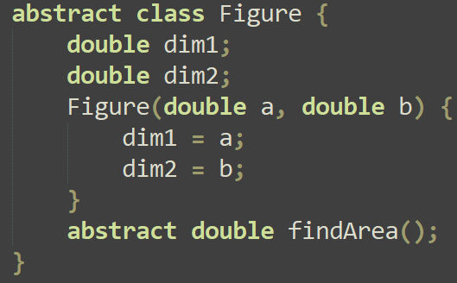
Object Oriented Analysis and Design using Java
Abstract class
Coding Example: If the abstract class contains the below data, how to implement Rectangle and Triangle classes?
class Rectangle extends Figure {
??
}
class Triangle extends Figure {
? ?
}

Slide 7
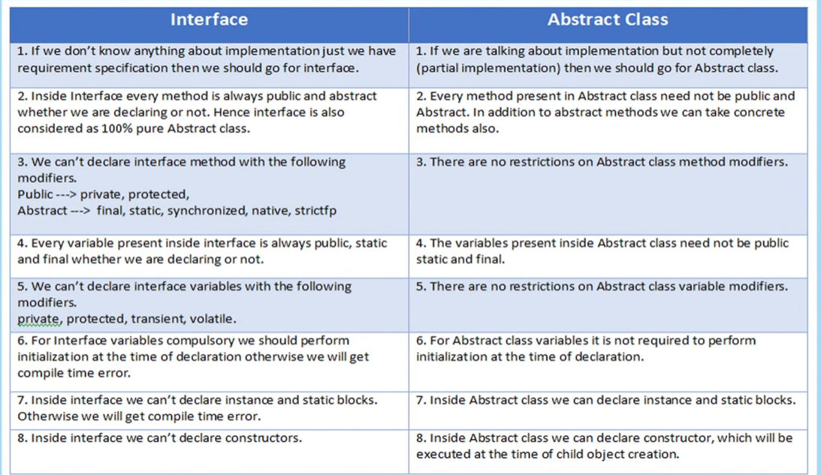
Object Oriented Analysis and Design using Java

Slide 8
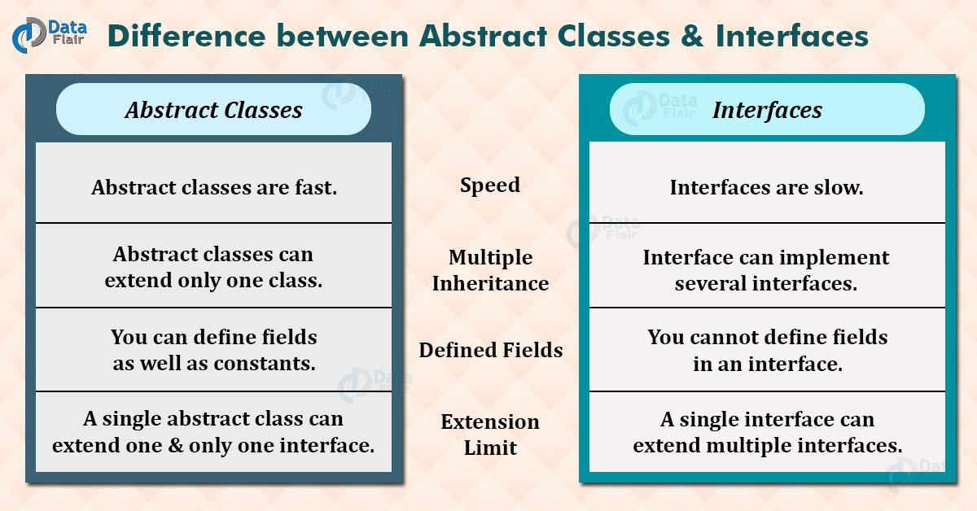
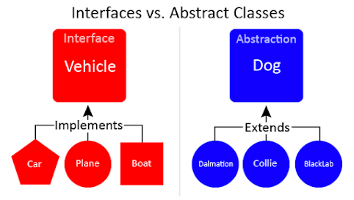
Object Oriented Analysis and Design using Java
Abstraction Vs Interface

Slide 9
Object Oriented Analysis and Design using Java
Abstraction Vs Interface

Slide 10
Object Oriented Analysis and Design using Java
Single Rooted Hierarchy
In Java all objects have common interface to implement and it makes implementation of Garbage collector lot easier in Java.
Implementation of Garbage Collector is became easy since required implementation is provided in the base class, enabling to send messages to every object.
As Java was created from scratch, it has no backward compatibility issues with any existing language
All objects in Java are inherited from same base class called 'Object'.
Same Base Class
Common Interface
It enables easy memory management
Simplifies argument passing amongst
object too on the heap.
The singly-rooted hierarchy is common with most other object-oriented programming languages.

Slide 11
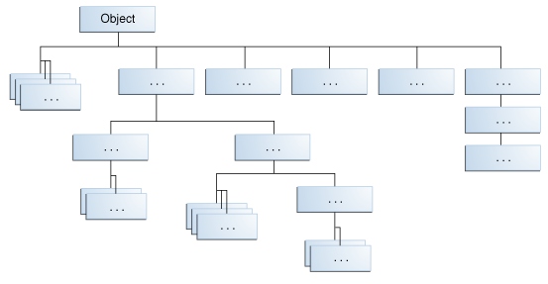
Object Oriented Analysis and Design using Java
Object class
Introduction
Object class defined by Java is a super class of all other classes, in the absence of any other explicit superclass
A reference variable of type Object can refer to an object of any class
This is defined in the java.lang package

Slide 12
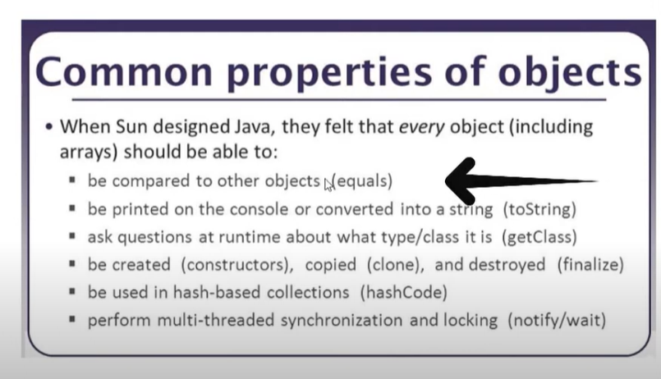

Slide 13
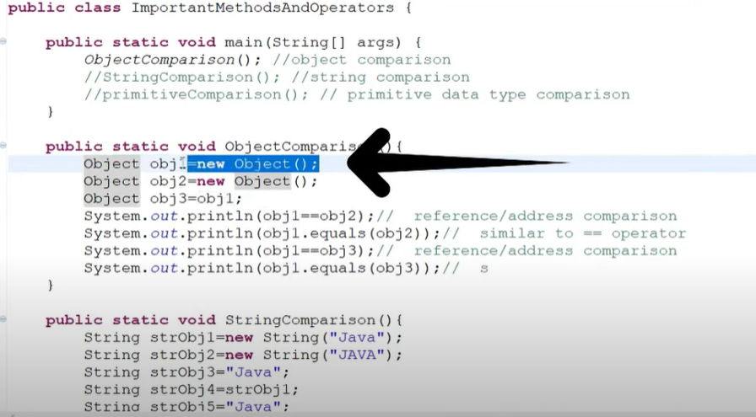
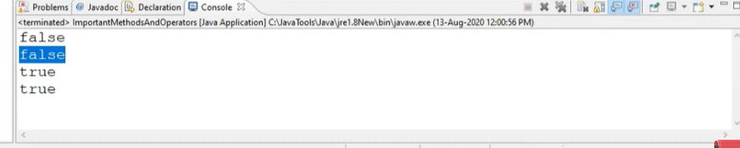

Slide 14
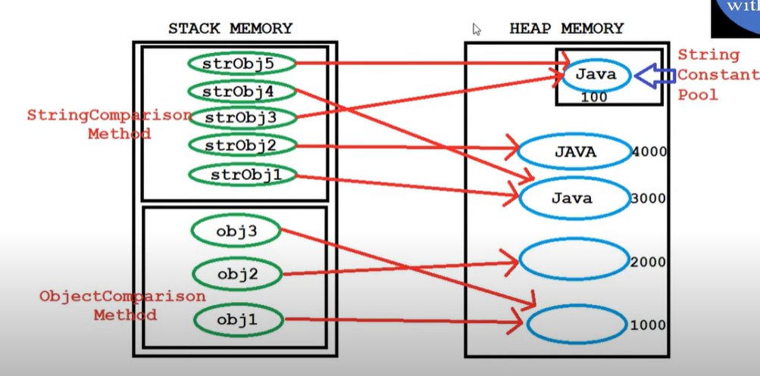

Slide 15
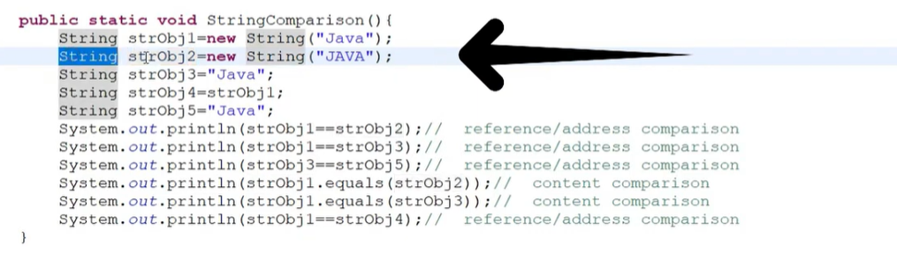

Slide 16
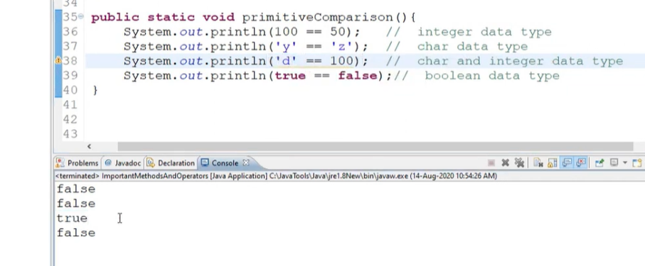

Slide 17
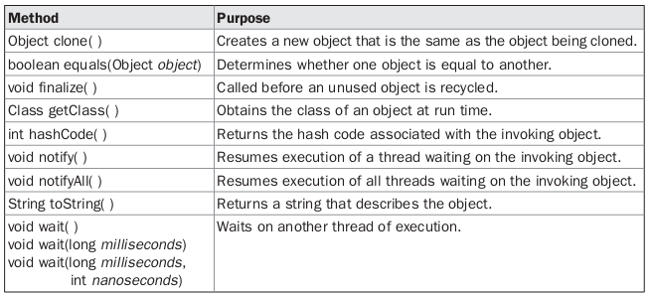
Object Oriented Analysis and Design using Java
Object class
Methods: Object class defines some methods, which are available in every object

Slide 18
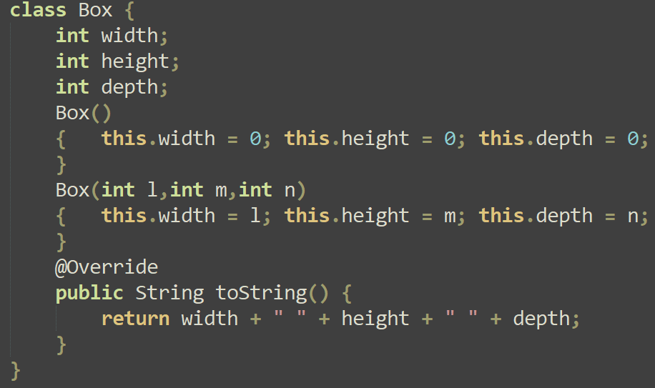
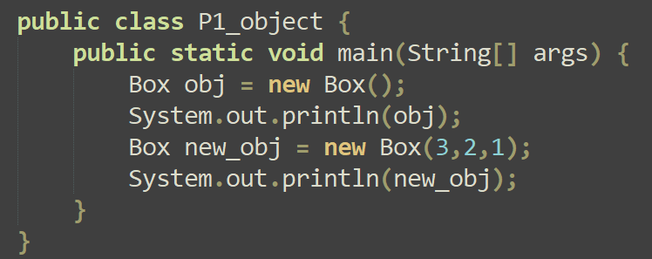
Object Oriented Analysis and Design using Java
Object class
Coding example – 1: Demo of overriding toString() function

Slide 19
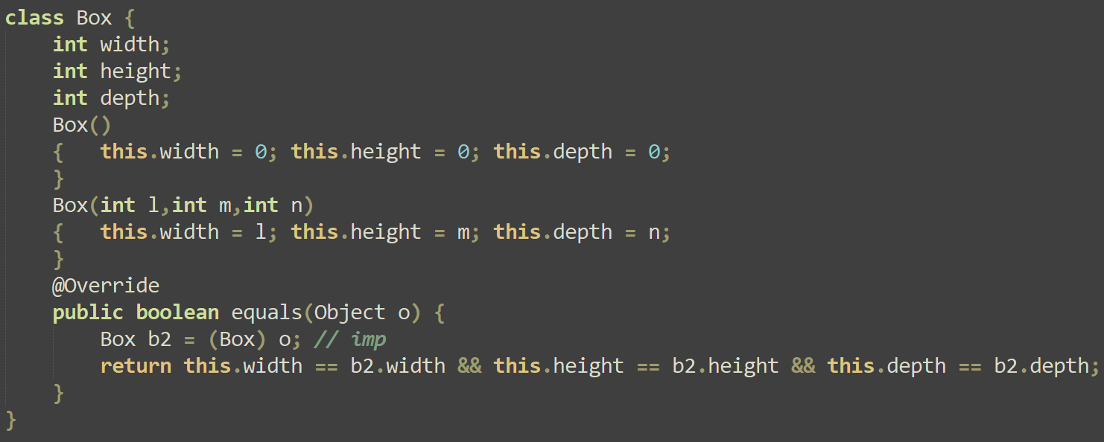
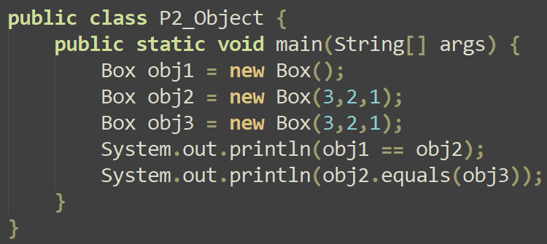
Object Oriented Analysis and Design using Java
Object class
Coding example – 2: Demo of overriding of equals() function

Slide 20
THANK YOU
Prof. Priya Badarinath and Sindhu R Pai
Department of Computer Science and Engineering
priyab@pes.edu, sindhurpai@pes.edu

